Slide 1
Restaurant management system
CAPSTONE PROJECT
Presented By:
S M Abdul Roshan 2021311001
Department of Applied Science And Technology
ACTech , Anna University.

Slide 2
OUTLINE
Problem Statement
Proposed System/Solution
System Development Approach
Algorithm & Deployment
Result
Conclusion
Future Scope
References

Slide 3
Problem Statement
The manual billing process causes delays for both consumers and the organization, highlighting a need for improvement. Implementing a computer-based billing system could optimize resource utilization. Such a system enables efficient entry of client, employee, and payment information, facilitating record management and addressing various data-related needs within the organization. Current challenges with the manual system include:-
Limited ability to modify data-
Reliance on manual operator control-
Excessive paperwork-
Challenges in timely information retrieval-
Difficulty in systematically recording information-
Paper wastage

Slide 4
Proposed Solution
The Restaurant Management System (RMS) is a software tool designed to simplify and speed up billing in restaurants. With an intuitive interface, RMS enables staff to process customer bills quickly, which helps reduce wait times. It can manage large amounts of data, allowing restaurants to easily keep track of billing history, reservation details, and staff information.
RMS is a desktop-based solution that requires minimal paperwork. It automates the calculation of bills, including any discounts, reducing the chances of errors and accelerating the billing process. All data is stored digitally in a secure database, minimizing the risk of data loss and eliminating the need for manual record-keeping. By using RMS, restaurants can operate more efficiently, streamlining important tasks like billing and reservations, and providing a smoother experience for their customers.

Slide 5
System Approach
Building a restaurant management system in Python involves a structured approach, consisting of the following steps:
*Understanding Requirements*: Start by analyzing the system's needs, covering menu management, order processing, reservations, inventory management, and reporting.
*Modular Organization*: Structure the system into separate modules, each dedicated to specific functions such as Menu Management, Order Processing, Reservation Handling, Inventory Management, and Reporting.
*Class Definition*: Define classes within each module to represent entities and actions. These could include Menu Items, Orders, Reservations, and Inventory Items.
*Establishing Relationships*: Establish connections between classes/modules to illustrate their interactions. For example, how orders relate to menu items and how inventory levels are affected by orders.

Slide 6
System Approach
*Implementing Functionality*: Develop methods and functions within each class/module to execute necessary tasks, like updating menus, processing orders, managing inventory, and handling reservations.
*Optional User Interface*: Depending on requirements, create a user interface, whether it's a command-line interface, a graphical interface using libraries like Tkinter or PyQt, or a web-based interface with Flask or Django.
*Testing and Refinement*: Conduct comprehensive testing to ensure the system functions correctly and meets requirements. Refine the system based on feedback and test results.
*Documentation*: Document the system's design, functionalities, and usage instructions to facilitate future maintenance and development efforts.

Slide 7
Algorithm & Deployment
Enhanced Framework for Restaurant Management:
*Efficient Menu Organization:* - Develop a structured menu item class capturing vital details like name, price, and description. - Establish a dedicated system for managing menu items, ensuring smooth addition, removal, and display processes.
*Streamlined Order Processing:* - Create a robust order framework, integrating essential elements such as order ID, selected items, and total price. - Implement seamless functionalities for adding items, precise price calculation, and efficient order processing.
*Seamless Reservation Handling:* - Define a comprehensive reservation structure, encompassing key details like reservation ID, customer name, date, and table allocation. - Design an intuitive reservation management system, enabling easy reservation creation, availability checks, and cancellations.
*Effective Inventory Management:* - Introduce a well-organized inventory framework, highlighting critical attributes like item name, quantity, and price. - Develop efficient inventory management tools for smooth stock addition, dynamic quantity updates, and proactive low stock alerts.

Slide 8
Algorithm & Deployment
*Insightful Reporting Mechanisms:* - Incorporate advanced reporting functionalities to generate customized reports, including sales and inventory insights tailored to specific user needs.
*User-Centric Interface Design:* - Craft an intuitive interface to enhance user experience, offering flexible options such as command-line, web-based, or GUI interfaces tailored to user preferences.
*Flexible Deployment Strategies:* - Explore diverse deployment approaches, including local deployment with PyInstaller, web-based deployment using Flask or Django, mobile app deployment via Kivy or React Native, containerization with Docker, and hybrid deployment for comprehensive coverage.

Slide 9
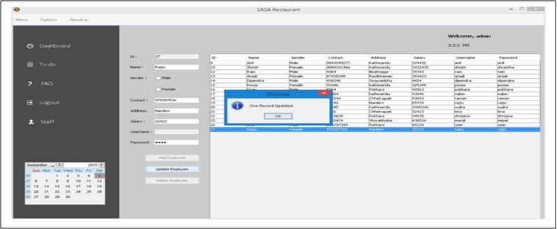
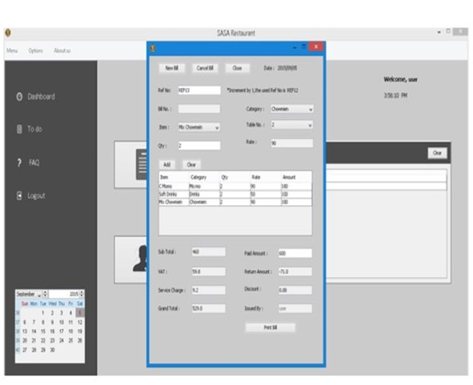
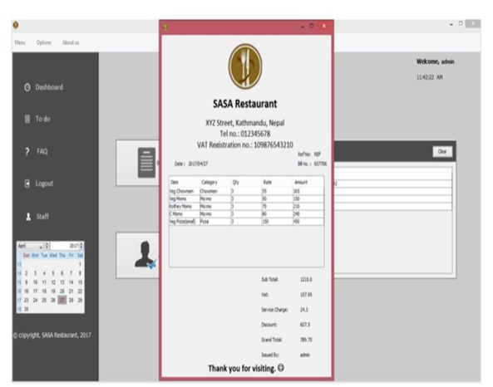
Result
Reflecting on the performance of the Restaurant Billing System, it effectively handles staff records, customer reservations, billing operations, and various other functions. Upon examination, the system showcases strong capabilities in managing staff information, including adding, editing, updating, and deleting records. Furthermore, it facilitates reservation creation and cancellation, along with bill generation for customers. The system's outputs are illustrated in the figure below for reference.

Slide 10
Conclusion
The documentation provides a comprehensive overview of the structure and coding for the Restaurant Management system. Developing this program was a challenging endeavor that required significant analysis, extensive research, and specialized skills. Creating this report has been an enriching experience, with many valuable lessons learned due to the complex nature of the required tasks. Designing a system for a restaurant involved a blend of research and technical skills, and ensuring a seamless operational flow was both exhausting and time-consuming.Despite the difficulties, the program has been successfully developed with a solid design and a smooth operational workflow. The billing module proved to be the most critical and challenging part of the project. Retrieving data from the database for billing was a complex task, requiring careful handling of multiple database changes using SQL queries, which was both time-intensive and intellectually demanding. Overall, this project has provided extensive coding experience and emphasized the importance of effective time management and teamwork in system development.

Slide 11
Future scope
The restaurant management software (RMS) encompasses a range of essential functionalities crucial for efficient restaurant operations, including staff management, order processing, billing, menu administration, reservation handling, order history viewing, task management, and more. Additionally, the software is poised for future enhancements and upgrades to further elevate its capabilities. Potential enhancements such as advanced inventory management, wireless tableside ordering and payment solutions, real-time alerts, online ordering integration, and mobile management capabilities hold the promise of boosting revenue streams and optimizing operational costs.

Slide 12
References
Restaurant Billing System: https://www.scribd.com/doc/283903672/Online-Ordering-System-
Project Objective : https://www.scribd.com/document/36253350/04-Project-Billing-
System Scopes and Limitation: https://kungfumas.files.wordpress.com/2017/09/099.pdf
Feasibility study: http://www.slideshare.net/alok104/synopsis-on-billing-system-27487568
UML Diagram : https://www.techopedia.com/definition/3243/unified-modeling-language-uml/
Use Case Diagram: http://whatis.techtarget.com/definition/use-case-diagram
Class Diagram: http://searchmicroservices.techtarget.com/definition/class-diagram
Sequence Diagram : https://creately.com/blog/diagrams/sequence-diagram-tutorial/
ER Diagram: http://searchcrm.techtarget.com/definition/entity-relationship-diagram
Interfaces : https://www.youtube.com/watch?v=9K5sS7j5wWI

Slide 13
THANK YOU

